Slide 1

Project Title -Predicting the Selling Price of Used Cars based on various features to assist buyers and sellers in the car market.
AICTE ID- STU666a218d488df1718231437
[ Harsh Sharma ]
Mail ID-harsh0012300@gmail.com

Slide 2

PROBLEM STATEMENT
This problem focuses on developing a predictive model that can accurately estimate the selling price of a used car given its various attributes. The goal is to provide valuable insights for individuals buying or selling cars, and for market analysts to understand pricing dynamics.

Slide 3
Project Description User-Friendly Application: Helping a Buyer Find the 'Best' Second-Hand Car For someone looking to buy a second-hand car, the 'best' often means a good car at a fair price. Our model can help by predicting a fair selling price based on a car's features. This allows buyers to compare listed prices against predicted values to identify potentially undervalued cars or avoid overpaying.

Slide 4

WHO ARE THE END USERS?
Car Buyers: They can use this model to get a fair estimate of a car's value, helping them make informed purchasing decisions and negotiate prices.
Car Sellers: The model can assist sellers in pricing their vehicles competitively, ensuring they attract buyers while optimizing their returns.
Automotive Market Analysts: These professionals can leverage the model to understand key factors influencing car prices, identify market trends, and make strategic business decisions.
Used Car Dealerships/Platforms: They can integrate such a model into their systems for automated pricing, inventory management, and customer recommendations.

Slide 5

Technology Used
The solution was developed using the following technologies:
Python: The primary programming language.
pandas: A powerful library for data manipulation and analysis, used for tasks like loading the dataset, creating new features, and handling data structures.
scikit-learn (sklearn): A comprehensive machine learning library.
Colab Notebook: IDE used to read the .csv and running the code.

Slide 6
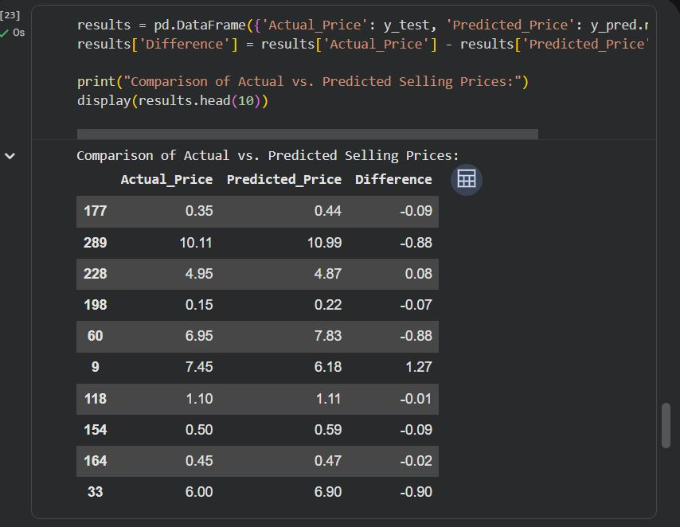
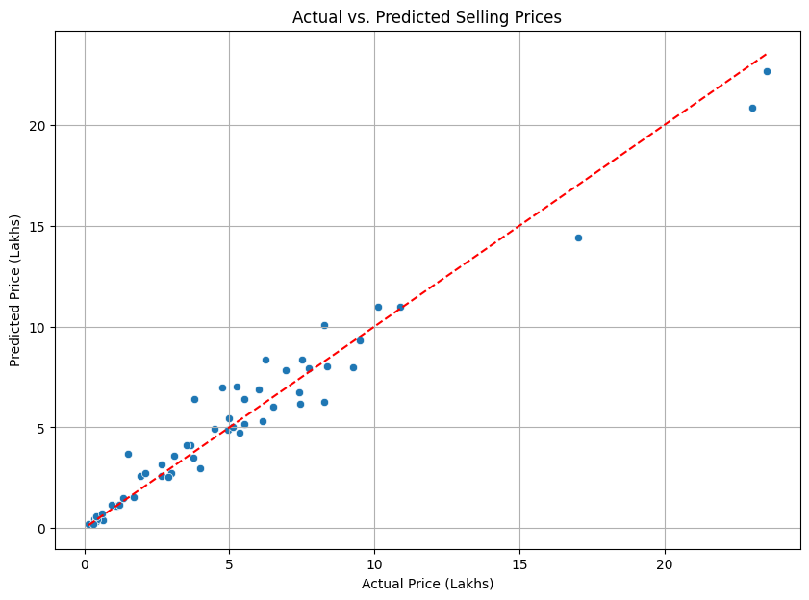
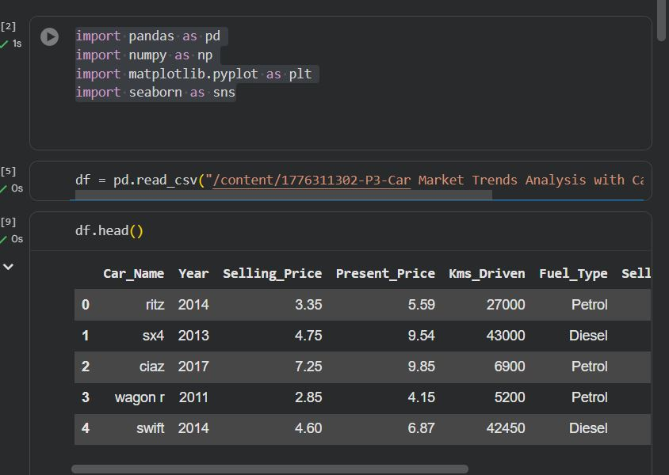
RESULTS
[Add screen shots of your code ]
GithubLink

Slide 7
Thank you
[ Harsh Sharma ]
Mail ID-harsh0012300@gmail.com
AICTE ID- STU666a218d488df1718231437
.
.

